Slide 1

Exploring the effects of home advantage in the NBA
SC1015 DSAI Mini Project
Lab Group FDAB
Lokeshh Sampath, U2221605A
Wu Yifan, U2220358A

Slide 2





Agenda
Problem Description, Goals, Motivation
Data Preparation and Cleaning
Exploratory Data Analysis
Machine Learning and model training
Insights and Discussion

Slide 3
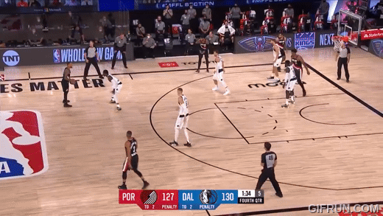
Problem Identification (motivations)
NBA bio-bubble
At the height of the pandemic…
Notes:
The year is 2020. Last seconds of a tight game between the Mavericks and the TrailBlazers. Damian Lillard has just fired one from 33 feet with seconds left to go in the game and swished it for the go-ahead basket. There were no loud cheers, no camera pans across all the excited faces, just the high fives and the whoops on the Portland bench.

Slide 4
Which factors contribute the most to home court advantage?

Slide 5





Problem Identification (background)
Historically,
The NBA has the biggest home advantage among all North American sports,
The home team wins ~60% of the time in the regular season and 65% of the time in the playoffs.
A Harvard study in 2008, found that the home team scored 3.24 points more than the visitors on average for seasons 04-05 and 05-06.
Possible Factors that affect Home Advantage:
Crowd
Support
Officiating
Familiarity with Environment
Travel Fatigue
Notes:
Historically, the NBA has the biggest home advantage in all of North American sports, with teams winning 56-58% of the time with this number increasing to 65% for just the playoffs. From the Celtics in the 90s using a lack of air-conditioning in their arena to the high altitude of the Nuggets’ arena, each team has a different advantage while playing at home. What truly are the indicators that determine home advantage? What is the most important one among them? Using these indicators, we hope that underperforming teams at home can identify how to improve their home records, and high-performing teams can maintain this advantage.
Home court advantage is a well-documented phenomenon in the NBA, where teams playing on their home court tend to have a significantly higher win percentage compared to playing on the road. This advantage raises intriguing questions about the factors that contribute to this statistical difference and how they might influence the outcome of NBA games and series.

Slide 6
Problem Identification (background)
Historically,
The NBA has the biggest home advantage among all North American sports,
The home team wins ~60% of the time in the regular season and 65% of the time in the playoffs.
A Harvard study in 2008, found that the home team scored 3.24 points more than the visitors on average for seasons 04-05 and 05-06.
Possible Factors that affect Home Advantage:
Crowd
Support
Officiating
Familiarity with Environment
Travel Fatigue
Arena Capacity
Audience Numbers
Notes:
Crowd support and noise
The energy and support of a home crowd can provide a significant adrenaline boost for players, potentially enhancing their performance. Conversely, boos and distractions from an away crowd can negatively impact composure and focus, hindering optimal execution. We will be using the arena capacity and audience numbers as a proxy for this measure.
Officiating
Subconscious bias may exist among referees due to the pressure of a roaring home crowd. Calls requiring more judgment (such as blocking vs. charging) tend to favor the home team. This leads to discrepancies in free throws and turnovers awarded, which significantly impacts the results of a game. However, this is hard to quantify, so we will omit it from our current discussion.
Familiarity with the environment
Players gain a distinct advantage from being intimately familiar with their home court, including subtle variations in lighting, sightlines, and the court itself. Particularly, we wish to further explore how altitude of certain arenas, which may adversely affect the stamina of visiting teams unaccustomed to the conditions, play a role in the home court advantage.
Travel Fatigue
The NBA's demanding travel schedule puts significant strain on players, with long flights, unfamiliar hotels, and disrupted sleep routines. The league tries to reduce travel, but often at the cost of more back-to-back games, which exhaust players further. Research indicates this fatigue contributes to home teams outscoring visitors by an average of 0.31 points (out of 3.24). We will use variables like difference in travel distance to account for this element.

Slide 7
Problem Identification (background)
Historically,
The NBA has the biggest home advantage among all North American sports,
The home team wins ~60% of the time in the regular season and 65% of the time in the playoffs.
A Harvard study in 2008, found that the home team scored 3.24 points more than the visitors on average for seasons 04-05 and 05-06.
Possible Factors that affect Home Advantage:
Arena Capacity
Audience Numbers
Travel Distance
Familiarity with Environment
Travel Fatigue
Altitude
Notes:
Historically, the NBA has the biggest home advantage in all of North American sports, with teams winning 56-58% of the time with this number increasing to 65% for just the playoffs. From the Celtics in the 90s using a lack of air-conditioning in their arena to the high altitude of the Nuggets’ arena, each team has a different advantage while playing at home. What truly are the indicators that determine home advantage? What is the most important one among them? Using these indicators, we hope that underperforming teams at home can identify how to improve their home records, and high-performing teams can maintain this advantage.

Slide 8

Problem Statement
How does factors identified contribute to a team’s home advantage in the NBA?
In this study, we aim to further explore the effects of home advantage, and answer:
Which identified factor is the biggest indicator of home advantage?
[Arena Capacity, Audience Numbers, Altitude, Travel Distance]
(2) Prediction of team performance at home using its underlying factors that affect home advantage [Multivariate Linear Regression, Random Forest Regressor, etc.]

Slide 9


Dataset used and Timeframe of Data selected
Dataset used: NBA Database, from Kaggle
In particular, we took 3 relevant CSV files
game.csv – which contains information about all games played
game_info.csv – which contains attendance of the individual games
team_details.csv – which contains the arena location and capacity
Choice of season:
2019-20, 2020-21, 2021-22
2022-23 season to be used as a test set for our machine learning models.
Analyse seasons during and after the COVID years, hence why we chose the most recent ones

Slide 10

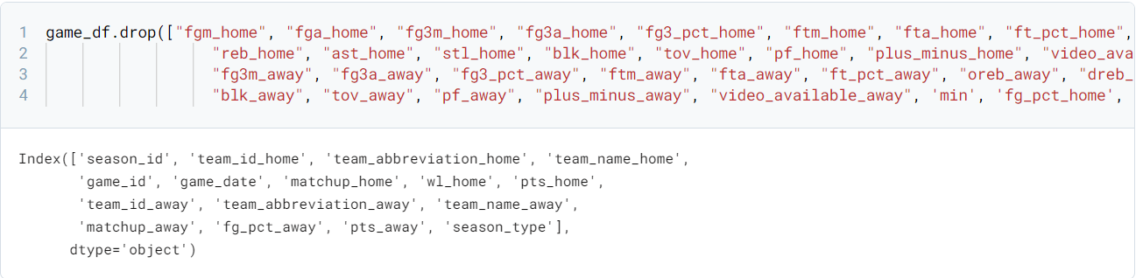

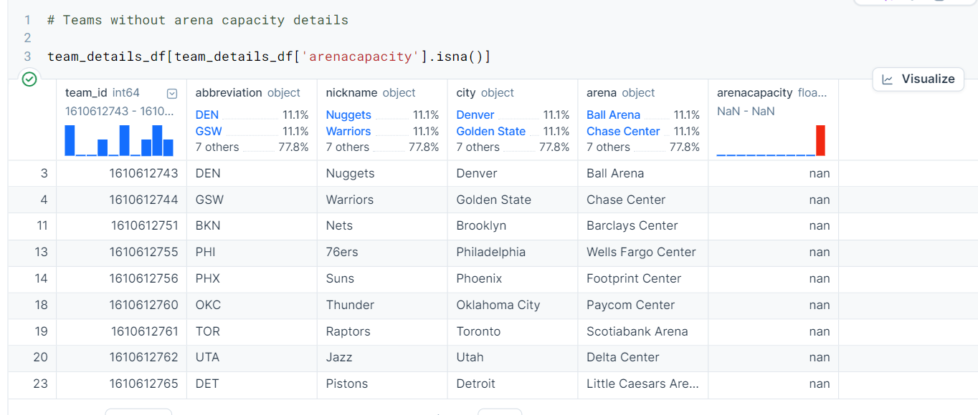
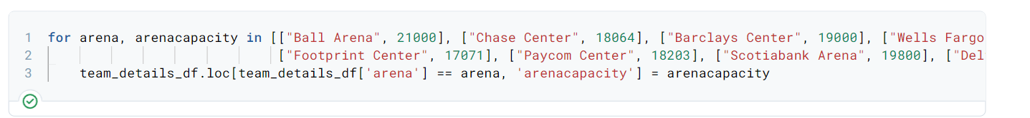

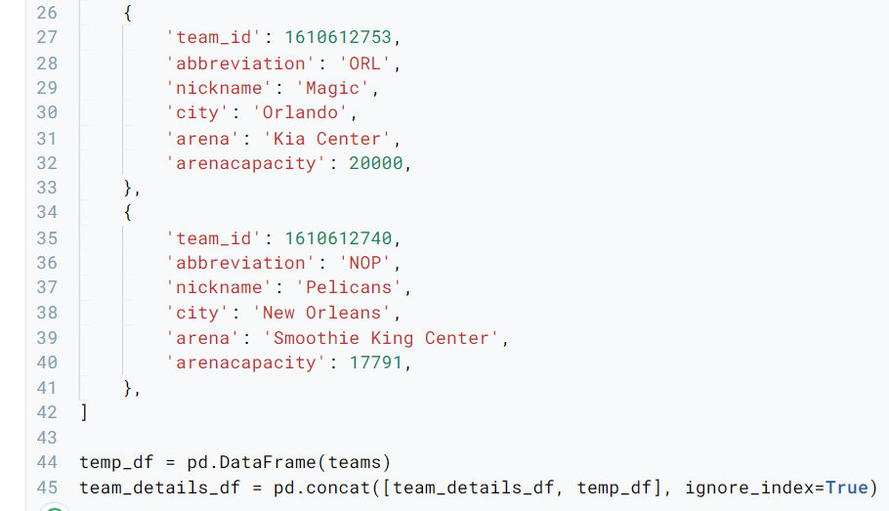
Dropping unnecessary columns and updating data for completeness
Dropping unnecessary data from the dataset
Adding of new data for completeness
(1) Update of arena capacities
(2) Append data from the remaining 5 teams
Certain arenas’ capacity not found,
The dataset also only contained 25/30 teams’ data.

Slide 11

Helper functions to calculate geographical metrics
Python Packages used: GeoPy
Mapping the arenas, so we can extract information like altitude, latitude and longitude
Finding out the travel distance for each visiting team for each game, implemented via a dictionary of all starting and ending cities and taking the geodesic distance between them.
Assumption: the teams travel straight from their previous game to the next game without going anywhere else first.

Slide 12
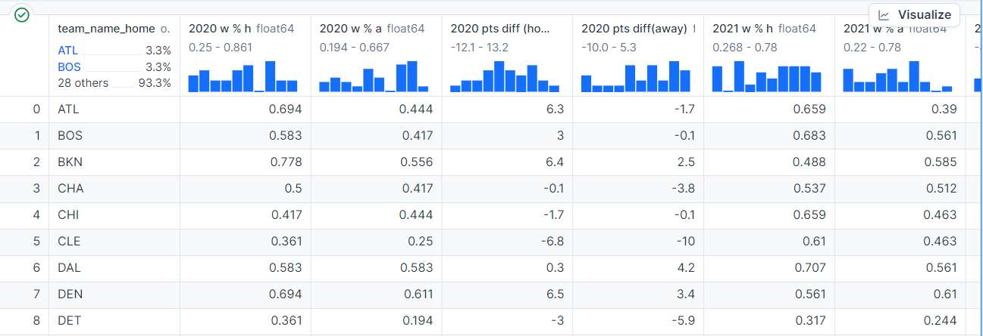
Creation of additional CSV, season.csv
We realised that…
The information we had collected was simply insufficient.
We had no data on our ‘target variables’ like Points Differential and Win %, used to ‘measure’ a team’s potential home advantage. Further processing was required.
Win %
Points difference

Slide 13
How do we measure Home Court Advantage?
Win/Loss Record Difference (Home – Away)
Impact of playing at home by looking at the percentage of games won on a team's court versus on the road.
W/L Record Diff = W % (home) – W% (away)
Point Differential (Home – Away)
The difference in points differential scored by a team when playing at home compared to away games.
Points Difference = points scored – points allowed
Points Differential = Points difference(home) – Points Difference (away)

Slide 14
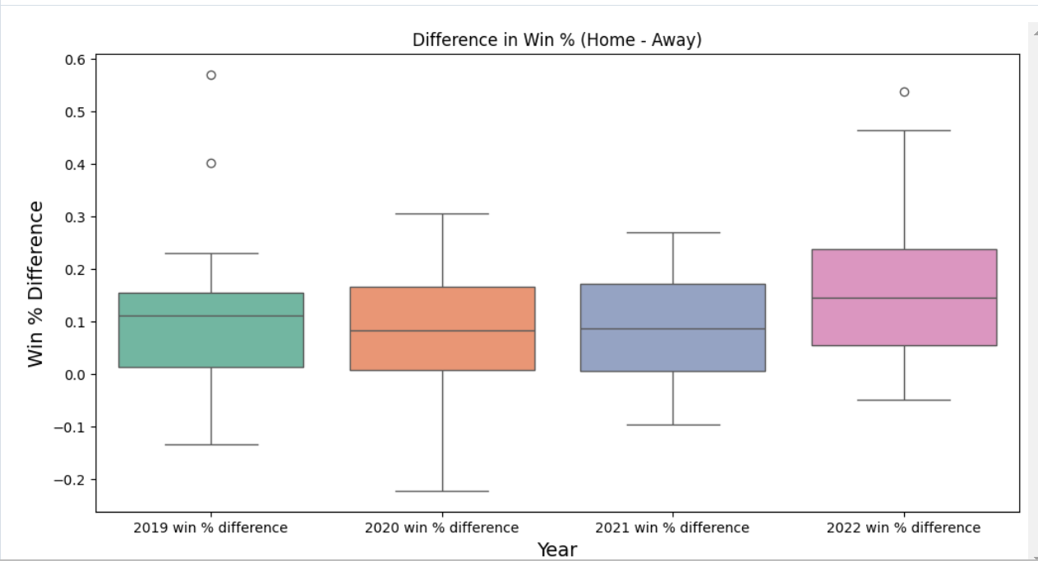
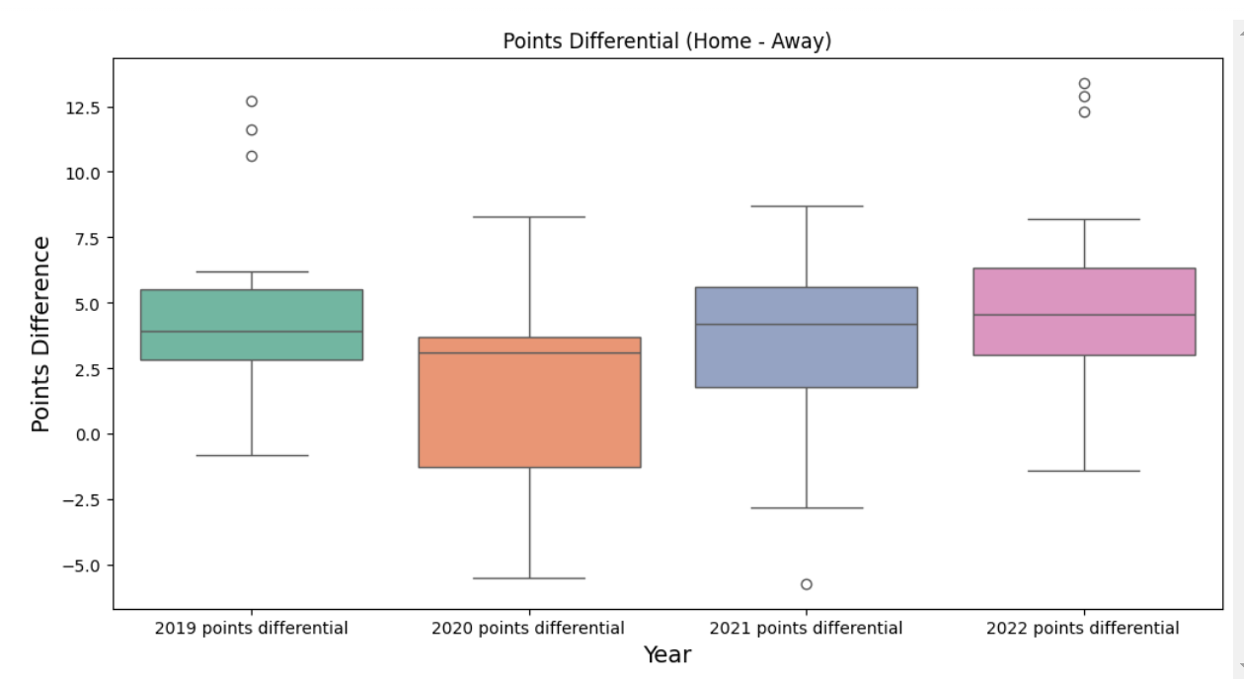
W % (home – away), Points Differential (home – away) (by year)
W % (home – away)
Points differential (home – away)
-Median > 0.0
-Inter-quartile range all in the positive range
-Median > 2.5
-Inter-quartile range mostly in the positive range
Initial indication of a potential home advantage

Slide 15
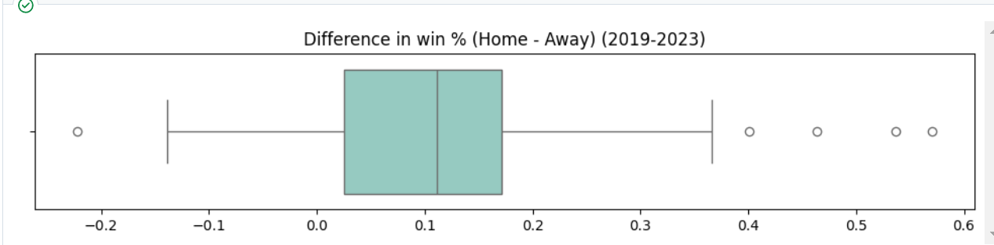
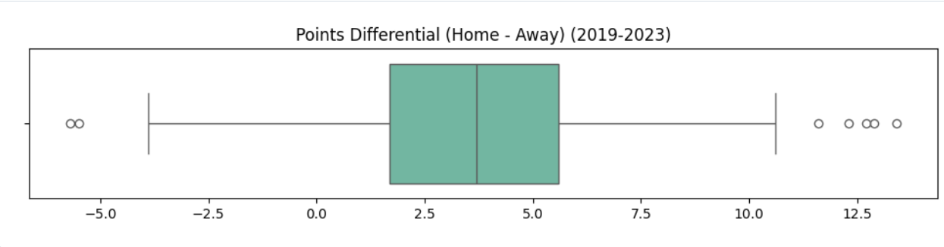
W % (home – away), Points Differential (home – away) (cumulative)
W % (home – away)
Points differential (home – away)

Slide 16
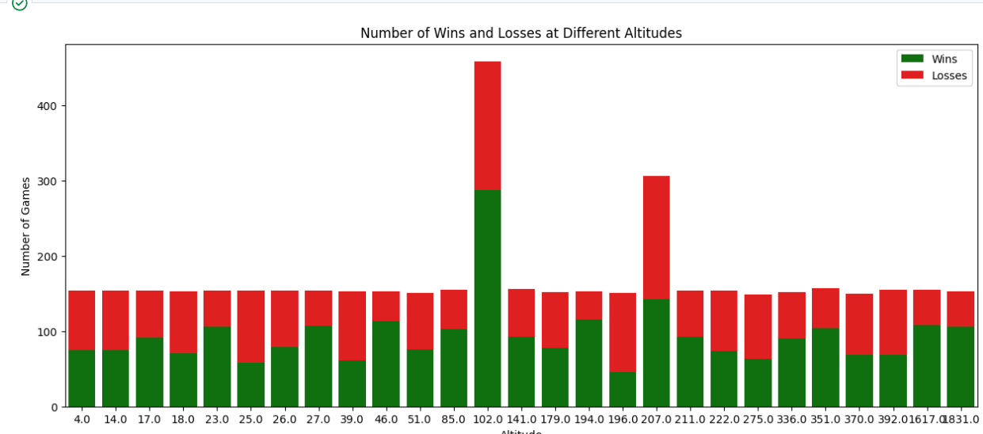
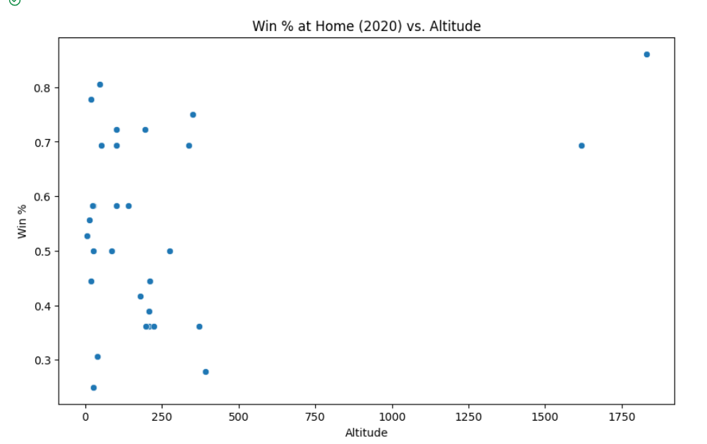
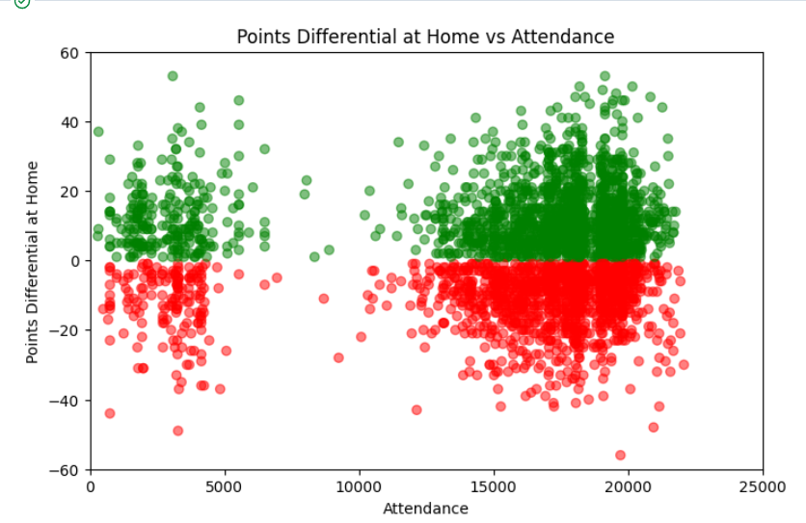
Altitude and Fan Attendance
Wins and loss numbers in each arena, by altitude
Win % at home vs altitude (season)
Points Differential at Home vs Fan Attendance
Generally inconclusive, some trends for altitude with the most elevated two arenas enjoying the best win % .
Historically, we know that altitude has a big part to play, e.g. in Denver Nuggets’ arena.

Slide 17

How do the individual variables about home advantage relate to win/loss and point difference?
Ultimately, can we use these variables to predict a team’s performance at home?

Slide 18


Machine Learning Models Used
Univariate Analysis
Multi-variate Linear Regression
Training Data: 2019-22
Test Data: 2022-23
Lasso Model, Ridge Model
Random Forest

Slide 19
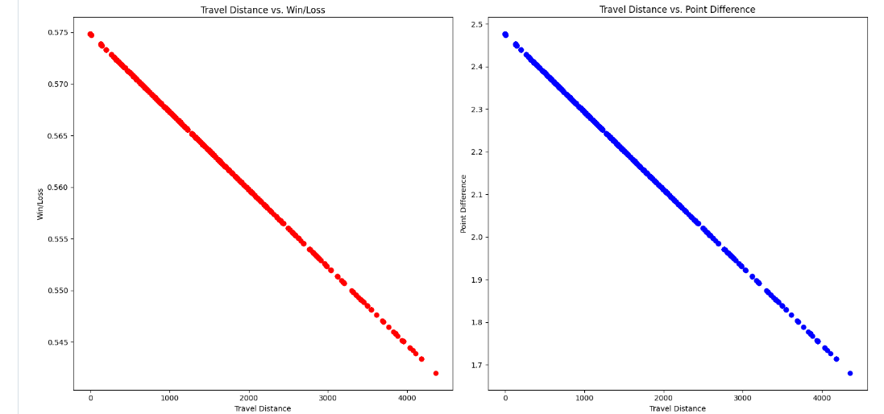
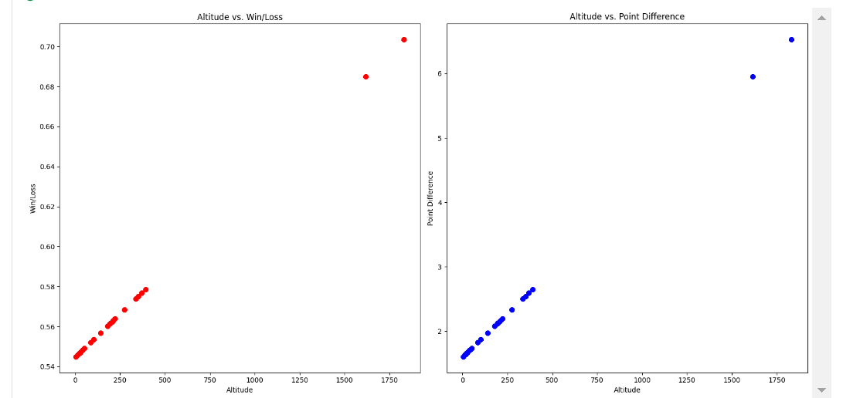
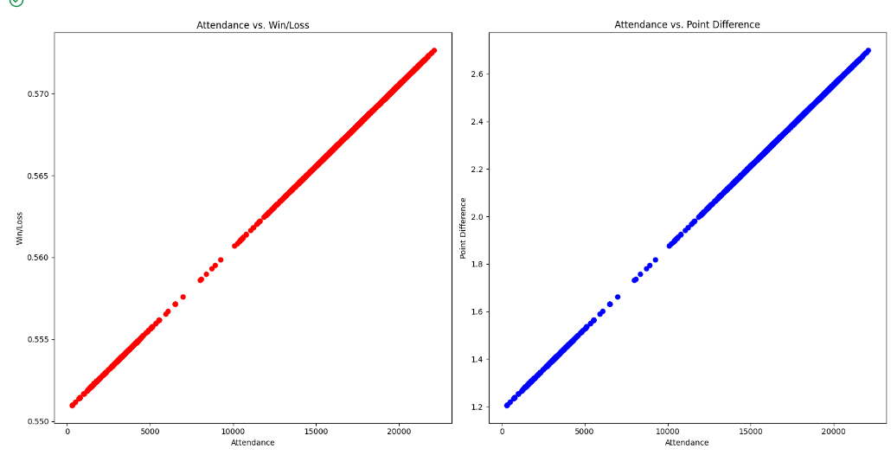
Model 1: Univariate Analysis
Here, we utilized univariate regression to see how the individual variables relate to the target variables
Travel Distance
Altitude
Attendance

Slide 20
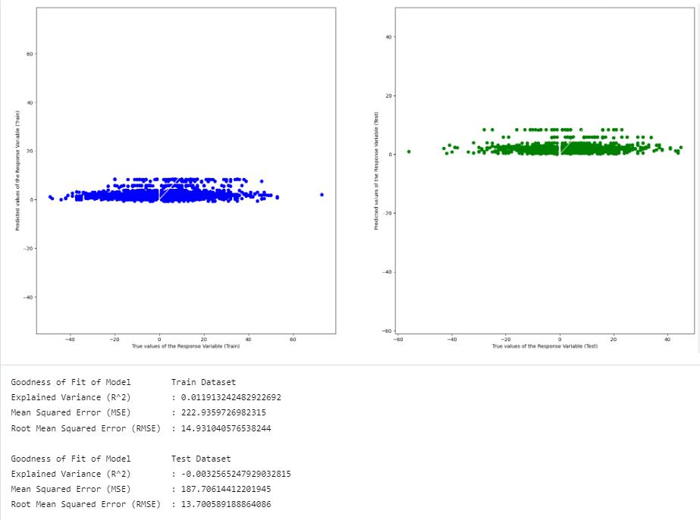
Model 2: Multi-variate Linear Regression
After understanding initial correlations, we can now proceed to multivariate regression to potentially predict our 2 end metrics, given the host of input variables.
Method
Results
1) Train-test split
2) Training model, based on train set
3) Test results on test set
Variables used
Attendance
Altitude
Travel Distance

Slide 21
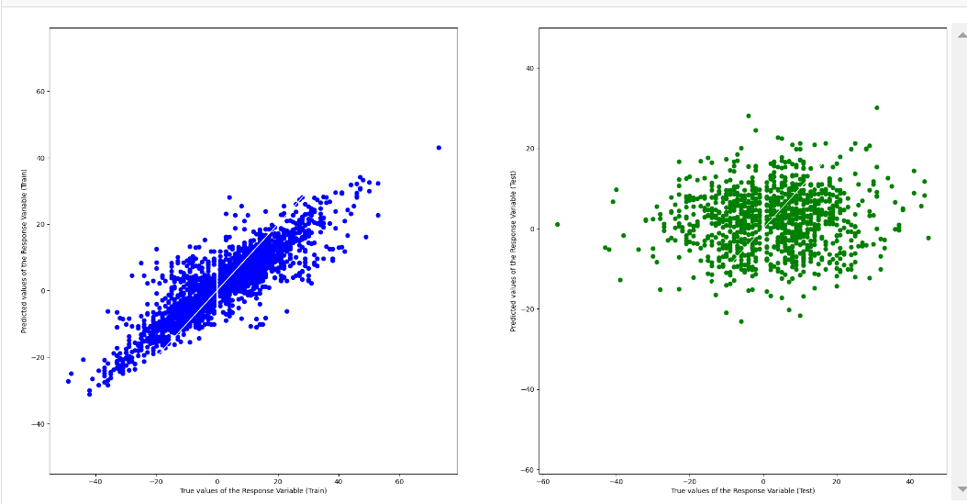
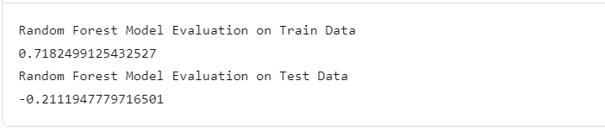
Model 3 : Random Forest
A supervised learning algorithm, that uses an ensemble learning method, where trees in random forests run in parallel, meaning there is no interaction between these trees during the building phase.

Slide 22



General Insights and Discussion
Poor results all around, from almost all the models used, even though machine learning techniques were sound
Interestingly, though it seems obvious that home advantage is a significant one, the data does not agree so
Possible reasons include the random nature of games, and the quality of data we analysed

Slide 23

Limitations and Future Works
While the approach was sound…
We did not fully understand the features being analyzed and their relationship with the metrics used.
Limited knowledge led us to use the most accessible models.
Critical data on individual matchup strengths and win probabilities was hard to come by due to the dynamic nature of NBA seasons.
Enhance comprehension of the features under analysis
Include additional factors influencing the analysis and utilize higher-quality data, reducing the need for proxies
More time and resources will be required

